Slide 1
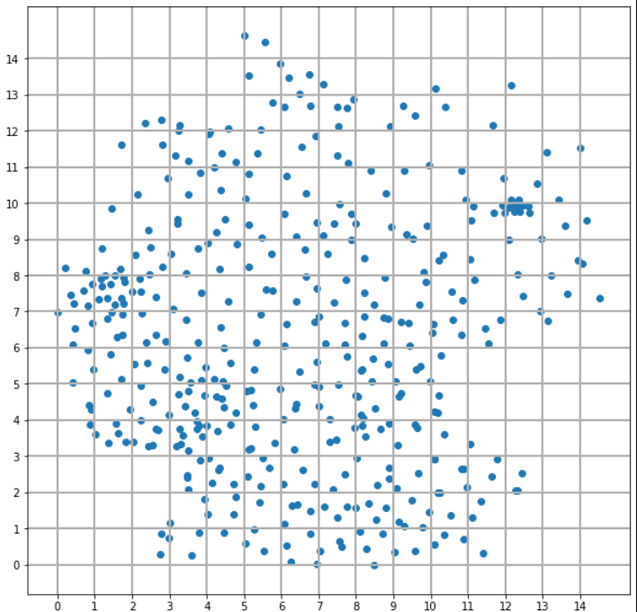

Slide 2
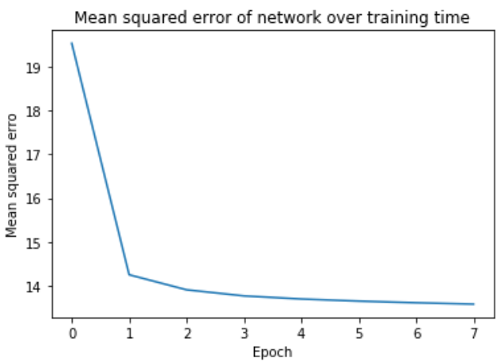
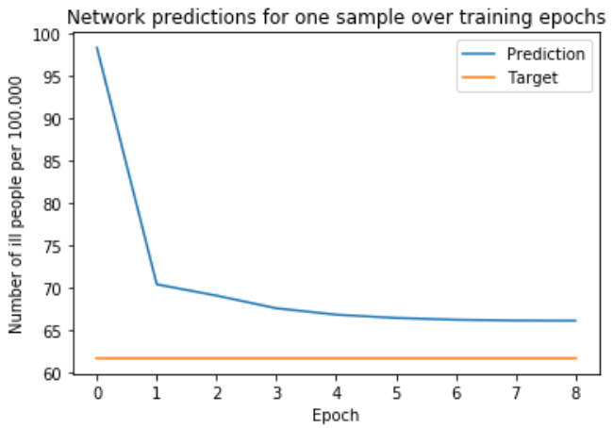

Slide 3
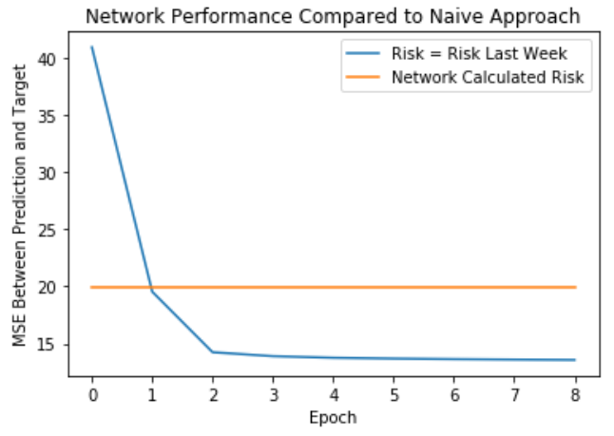

Slide 4
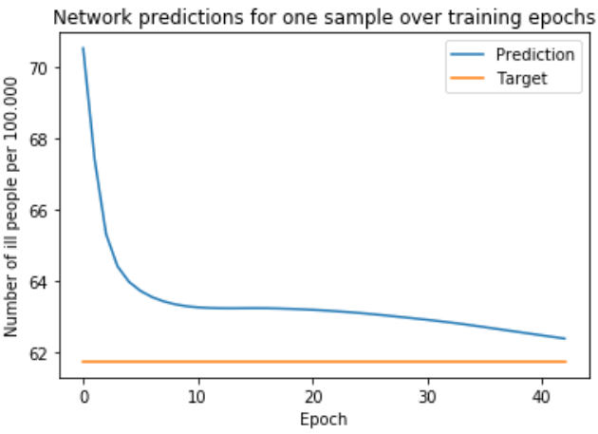
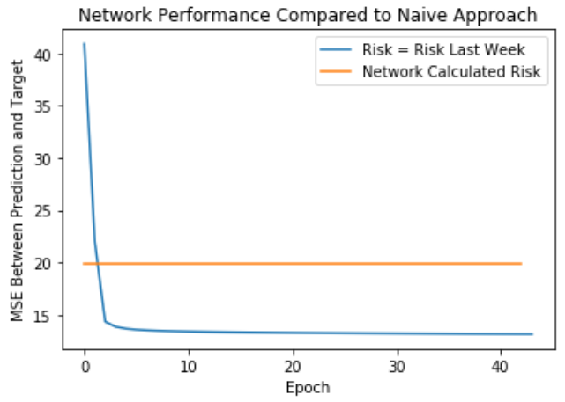
Now both networks combined:

Slide 5
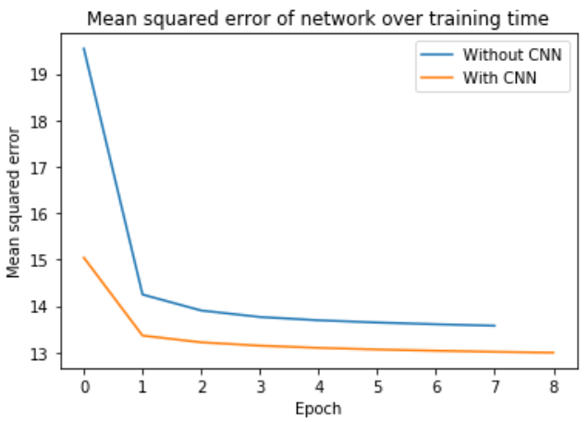

Slide 6
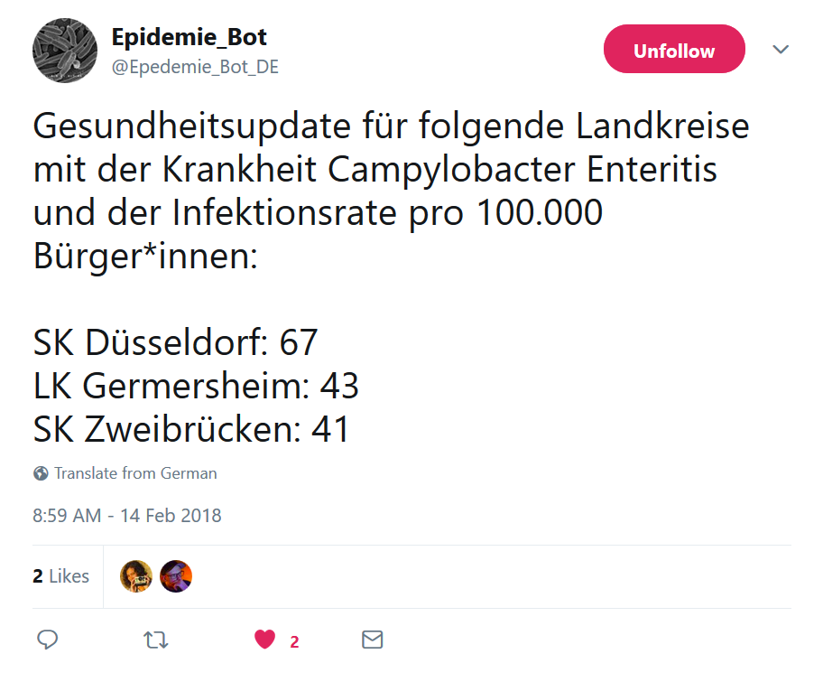
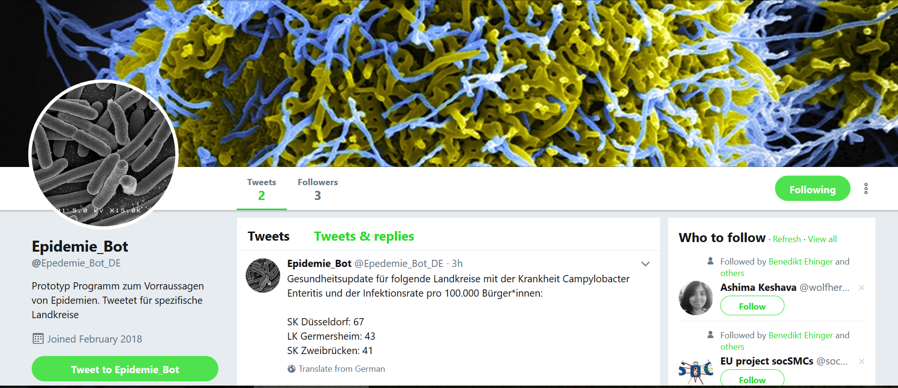

Slide 7

Medict
Predicting Disease Spread from Big Data
Made by Die Influenza

Slide 8

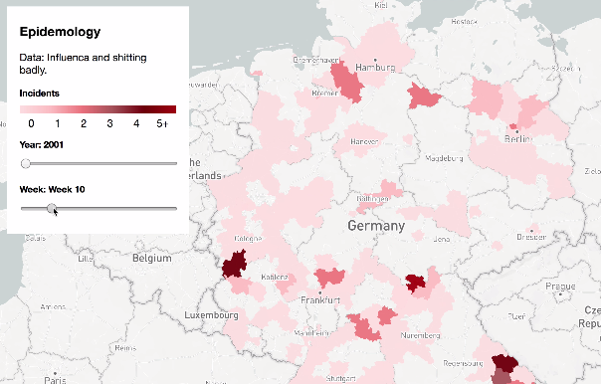




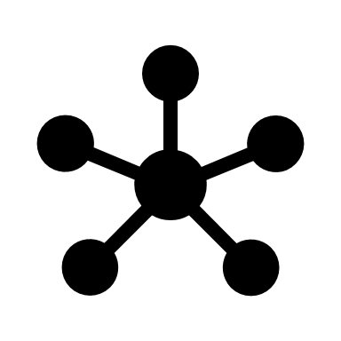




Future Research
Local Risk Alerts
Personal Risk
Robert Koch Institute
Artificial Neural Networks
Real Time Data
Ask about areas of risk
Archived health Data
Provide own symptoms
Provides diagnosis
Doctor
Visits doctor

Slide 9
Future Research
Local Risk Alerts
Personal Risk
Robert Koch Institute
Artificial Neural Networks
Real Time Data
Ask about areas of risk
Archived health Data
Provide own symptoms
Provides diagnosis
Doctor
Visits doctor

Slide 10
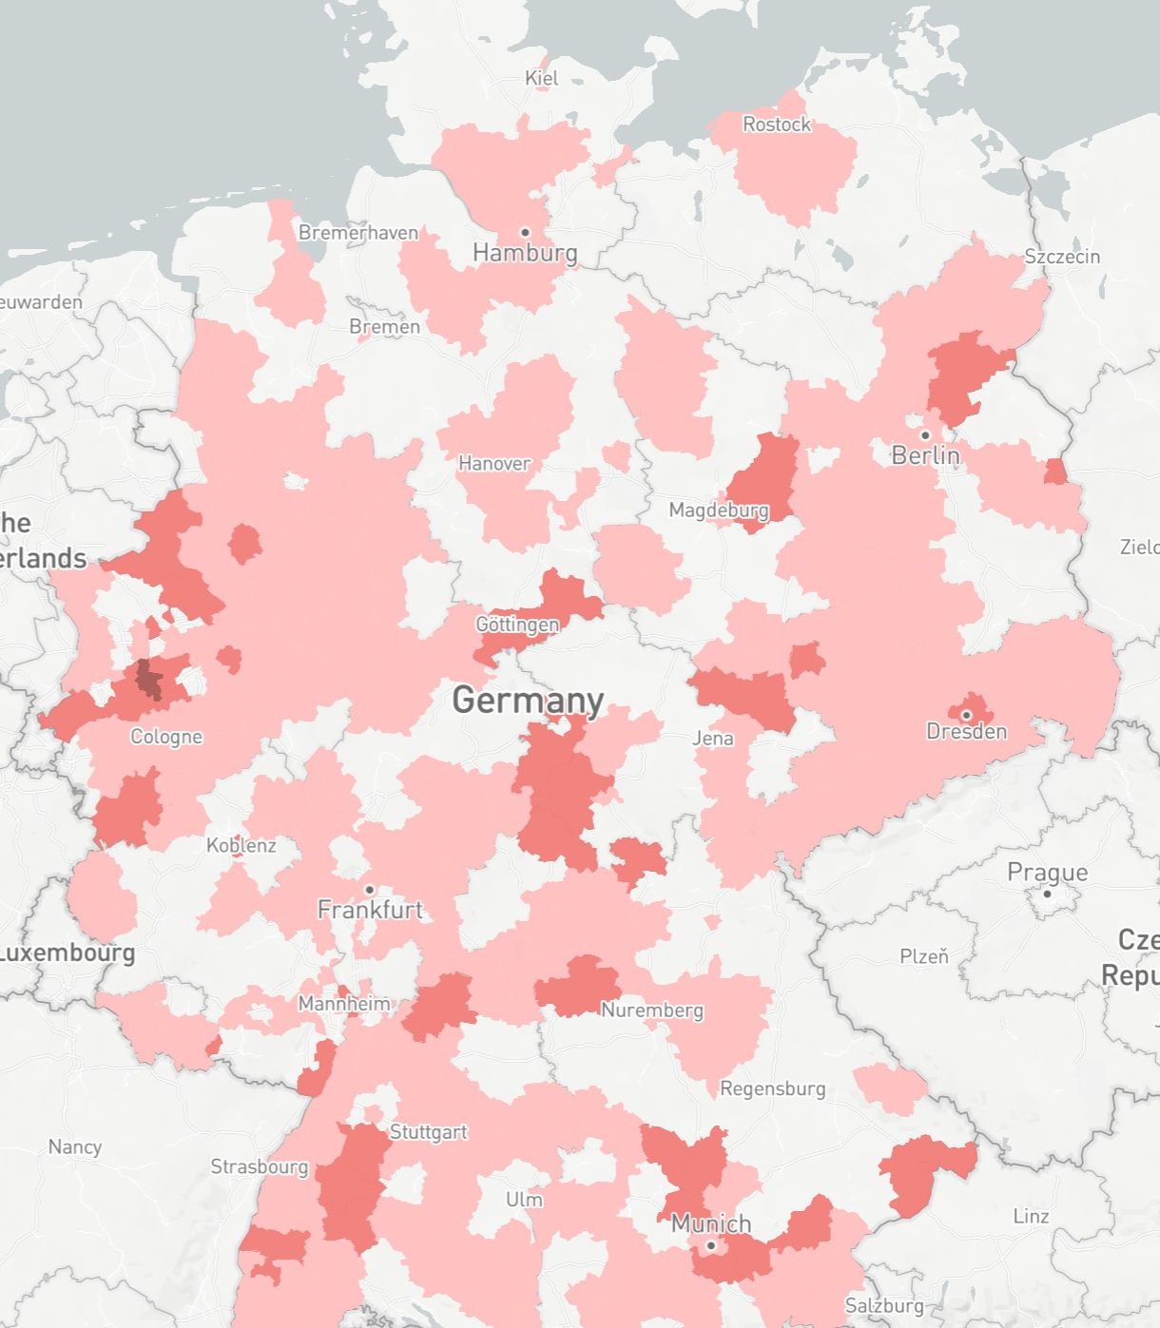
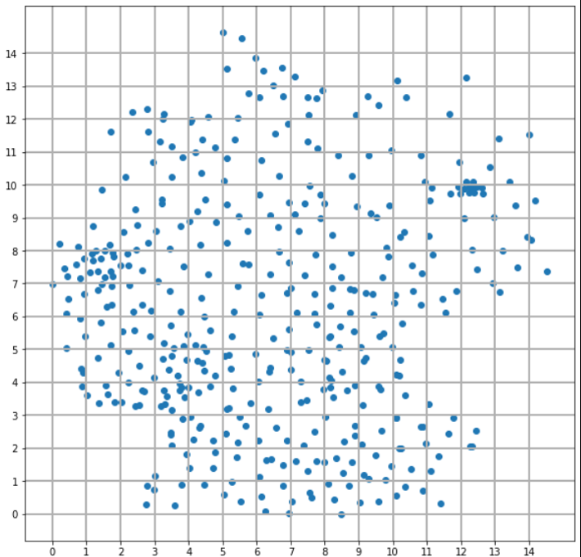
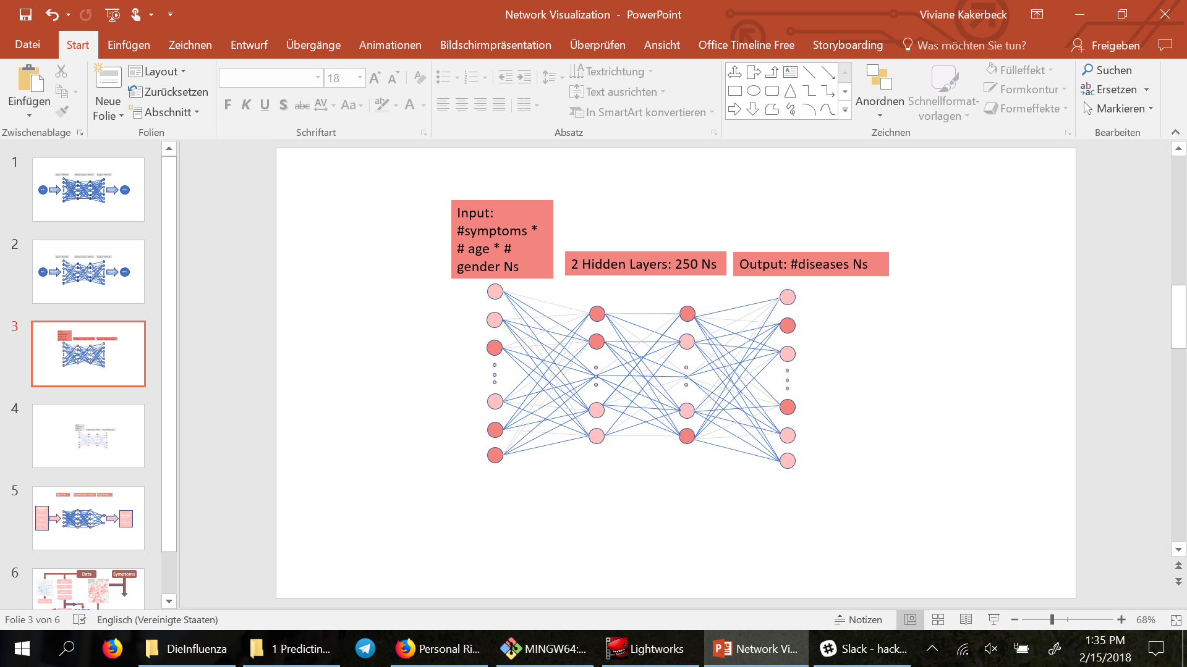
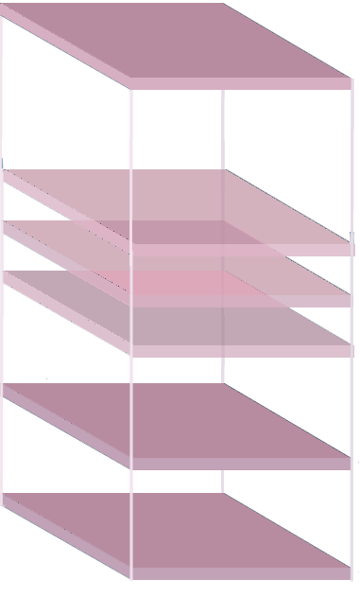
Data
Symptoms
GPS (X,Y)
Week
Count - LK
Incidence – LK
Incidence – Bin
Incidence Prediction Bin
Count – LK
Next week
Incidence – LK
Next week
Personal Risk for Diseases
CNN
FFN
FFN 2

Slide 11
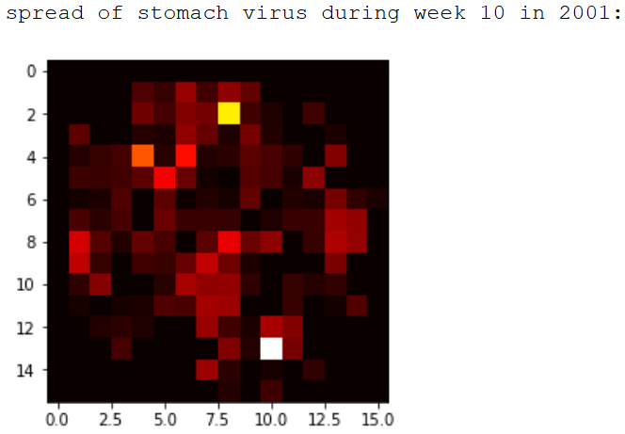

Slide 12
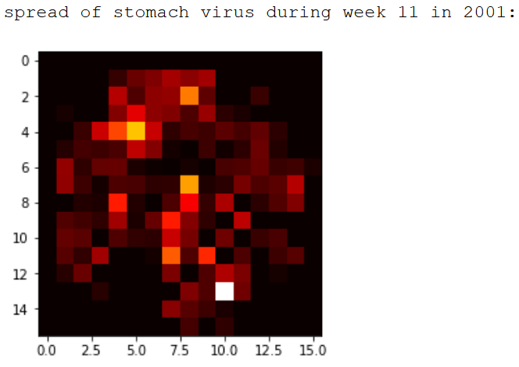

Slide 13
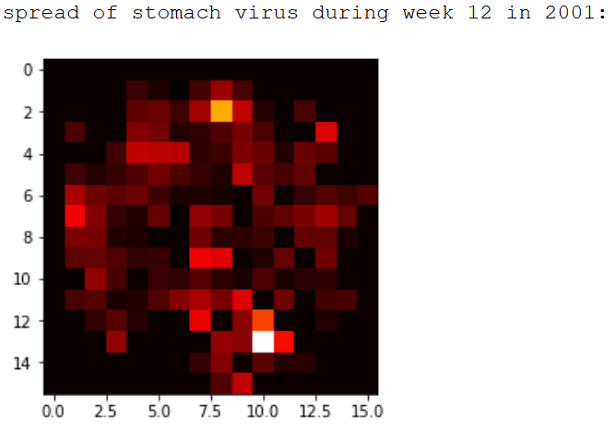

Slide 14
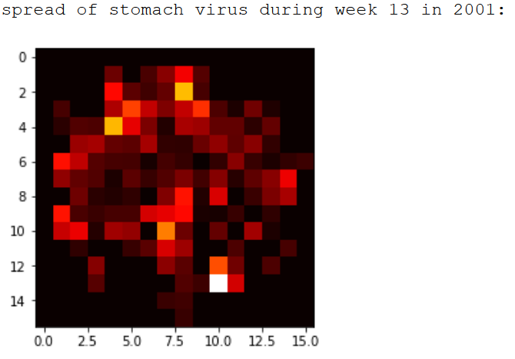

Slide 15
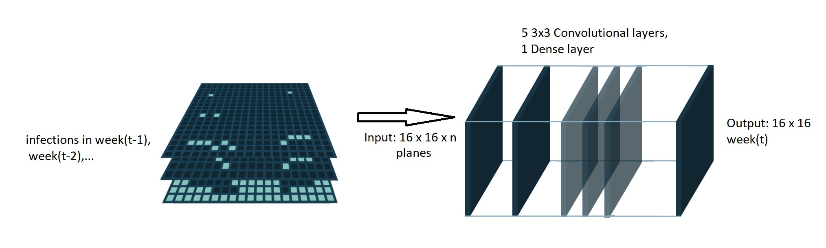
CNN Network Structure

Slide 16
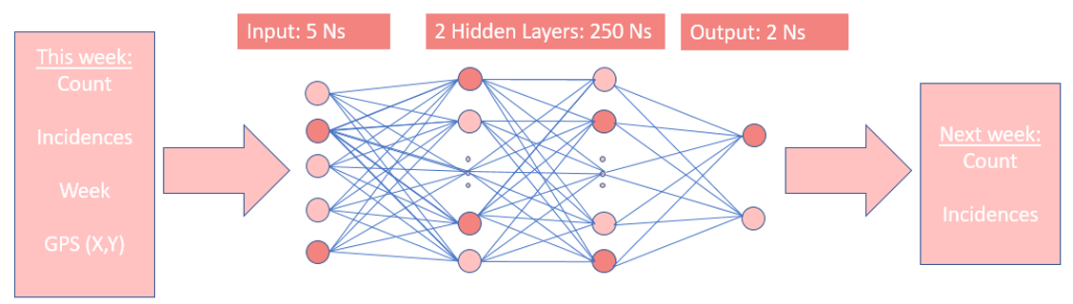
FFN Network Structure

Slide 17
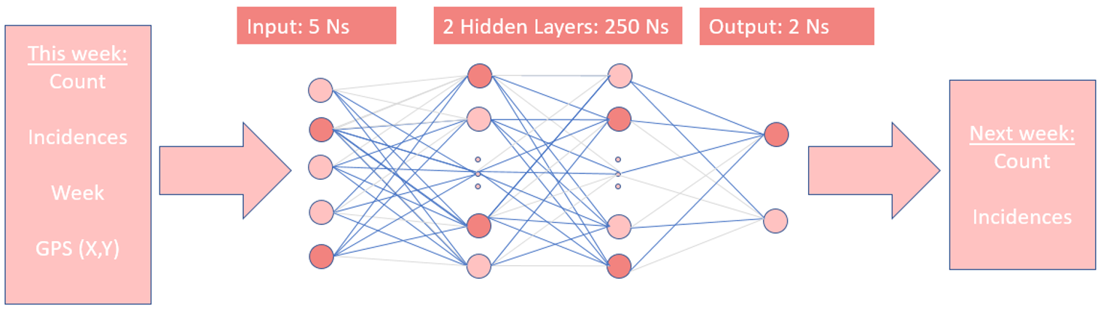
FFN Network Structure

Slide 18
Network Performance

Slide 19
Network Performance

Slide 20
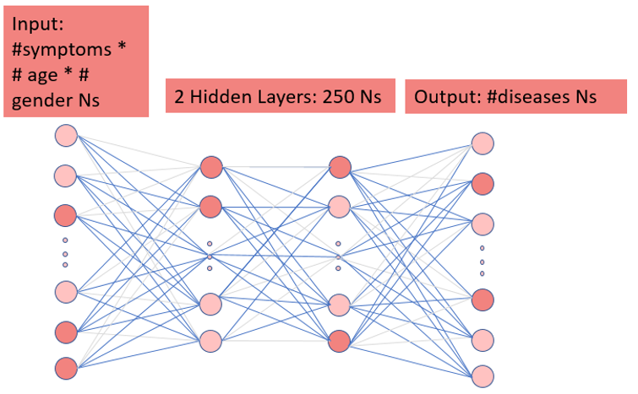
Symptom Network Structure (FFN)
Symptoms
Age
Gender
Probability for each disease

Slide 21
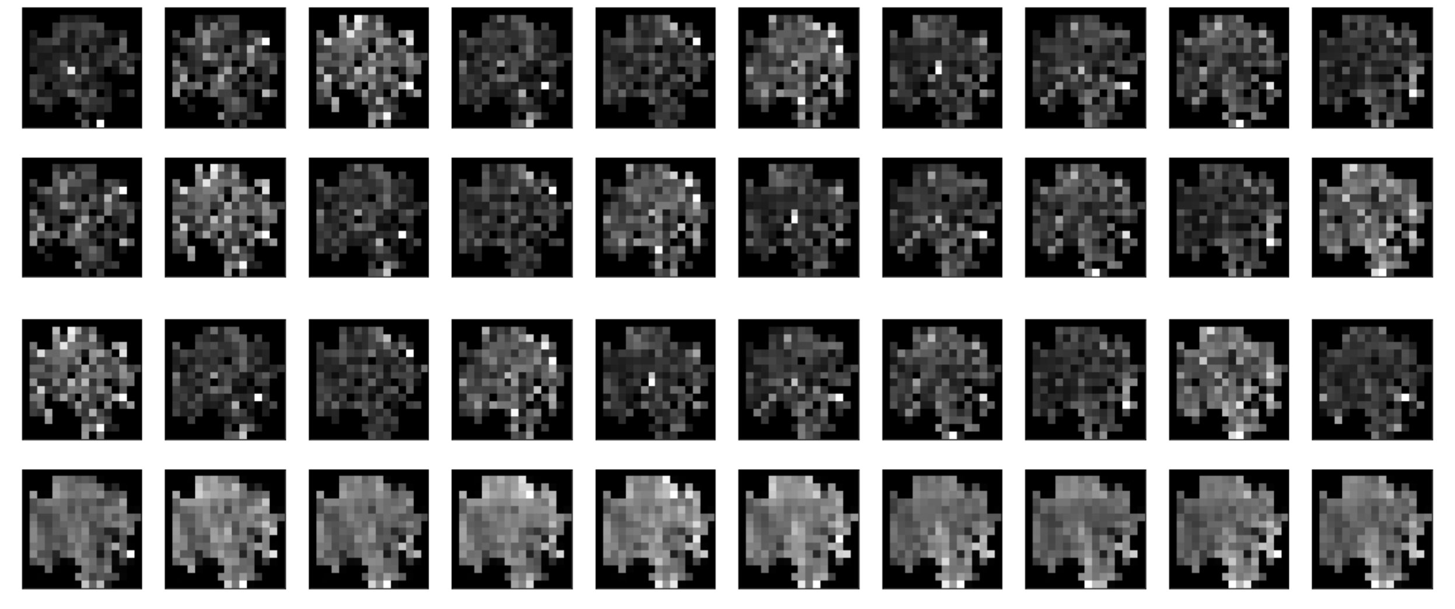
Discussion - CNN

Slide 22
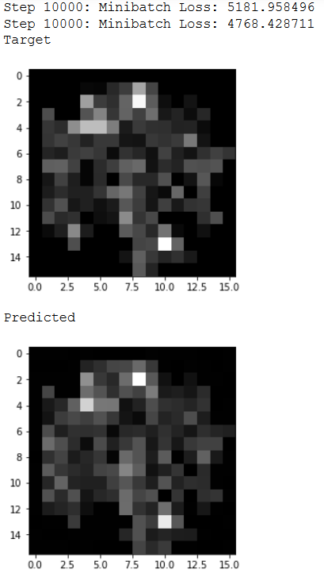
Discussion – Auto Encoder (CNN Alternative)

Slide 23
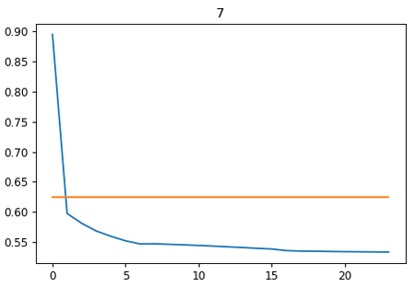
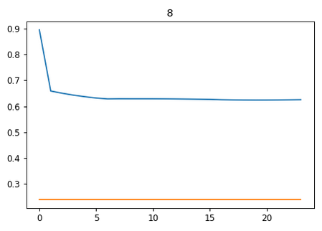
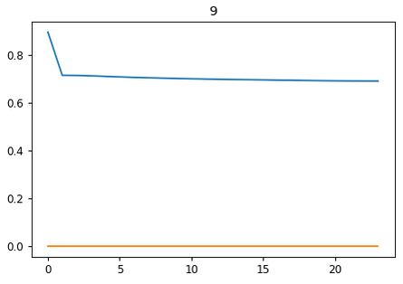
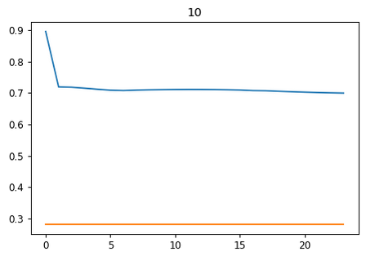
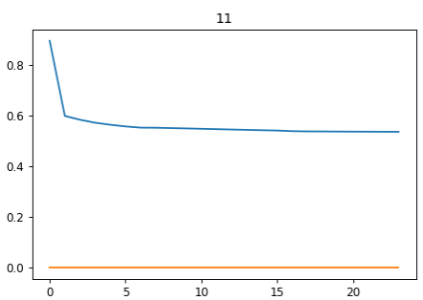
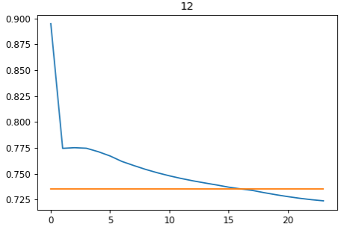
Discussion – FFN

Slide 24
Outlook
Make single application which pools all scripts and updates network on the fly
Add more diseases
Finish personal risk prediction
Determine factorization of location vs. symptoms (learn with network or empirical data?)
Hyperparameter search (eg. Resolution of CNN)
Incorporate into phone application
Validation by doctors?
Add more data (eg: weather, more cross over between networks, more previous data for FFN)

